Slide 1

DIABETES PREDICTION
SARIM AEYZAZ (i21-0328)

Slide 2
CONTENTS
Dataset Description
High Level Architecture
Extra EDA Analysis
Feature Engineering
Additional Models Added
Sampling Techniques
Hyperparameter Tuning
Evaluation

Slide 3
DATASET DESCRIPTION
Age (Numerical values: 0-80)
Gender (Categorical labels: Male, Female, Other)
Body mass index (BMI) (Numerical values: 10 – 95.7)
Hypertension (Boolean: 0 or 1)
Heart disease (Boolean: 0 or 1)
Smoking history (Categorical labels: Not Current, Former, No Info, Current, Never and ever)
HbA1c level (Numerical values: 3.5 - 9)
Blood glucose level (Numerical values: 80 - 300)
Diabetes (1 for Positive, 0 for Negative)
Length = 96128 Patients

Slide 4
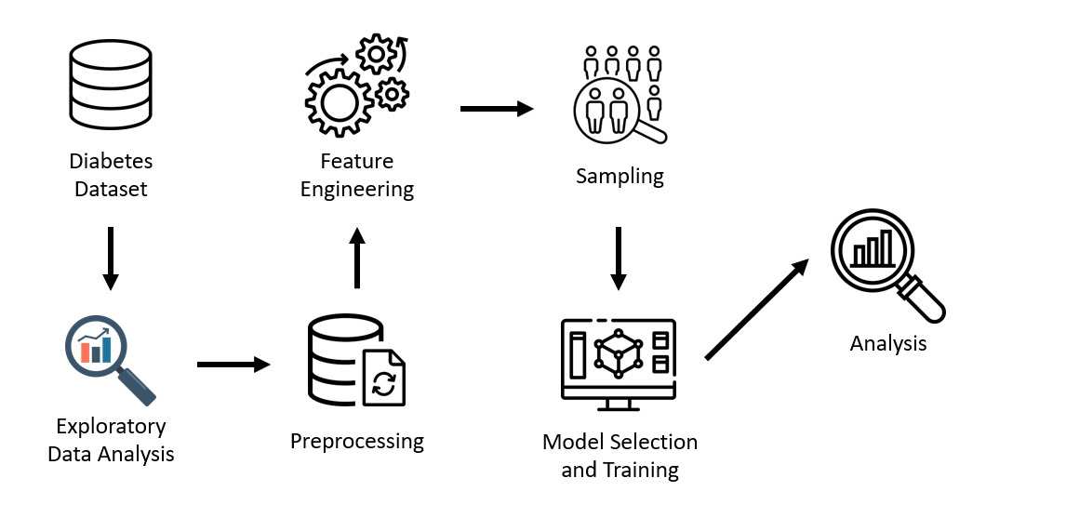
High Level Architecture

Slide 5
EXTRA EDA ANALYSIS

Slide 6
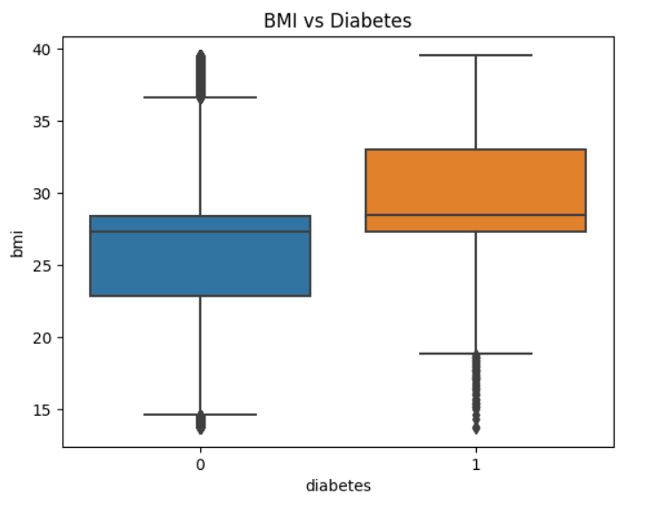
BMI & Diabetes

Slide 7
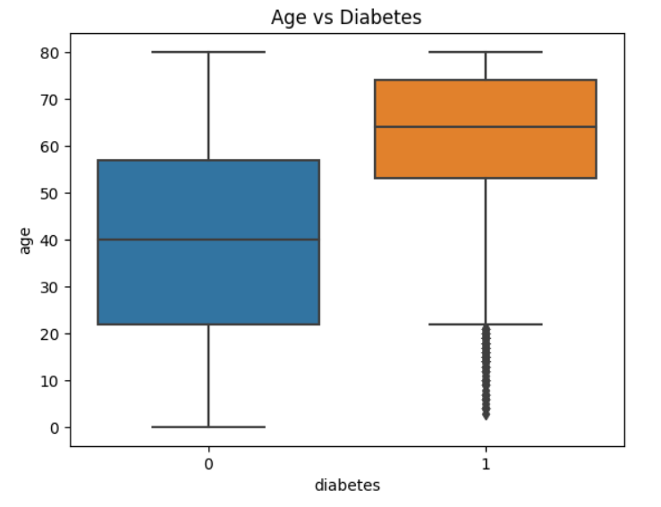
AGE & Diabetes

Slide 8
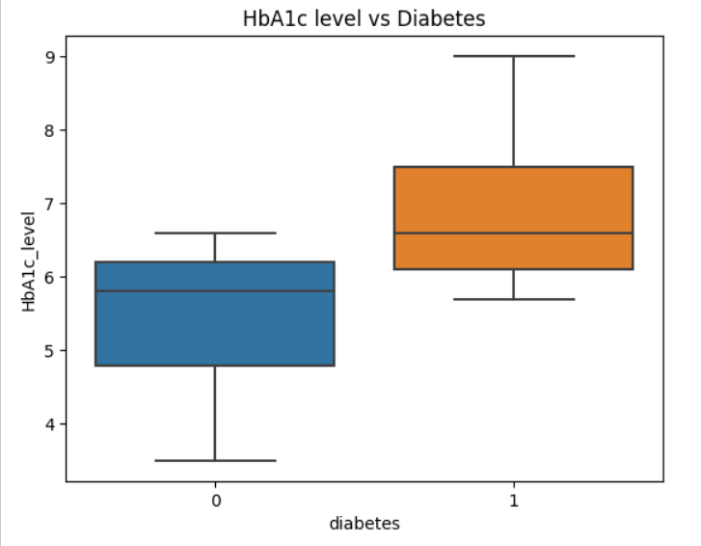
Hba1c & Diabetes

Slide 9
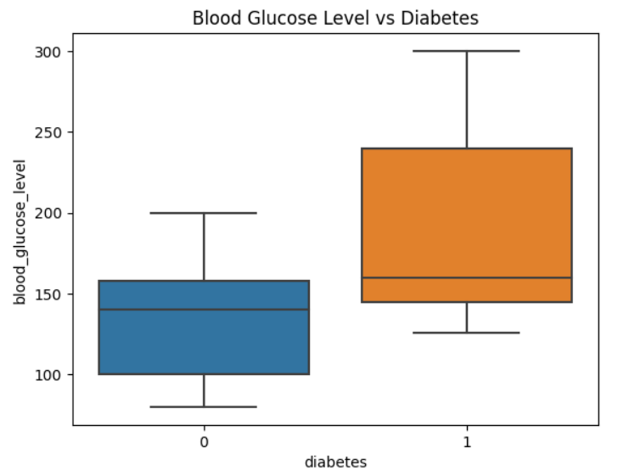
BLOOD GLUCOSE & Diabetes

Slide 10
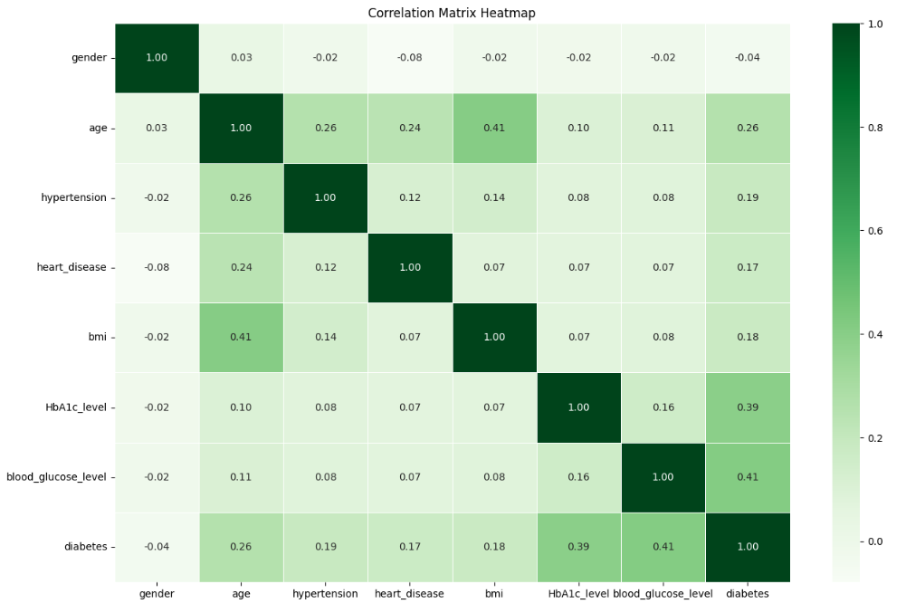
CORRELATION MATRIX

Slide 11
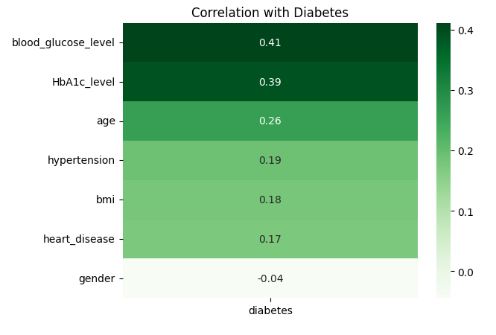
CORRELATION WITH DIABETES

Slide 12
FEATURE ENGINEERING

Slide 13
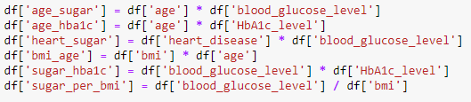
FEATURE CROSSING

Slide 14
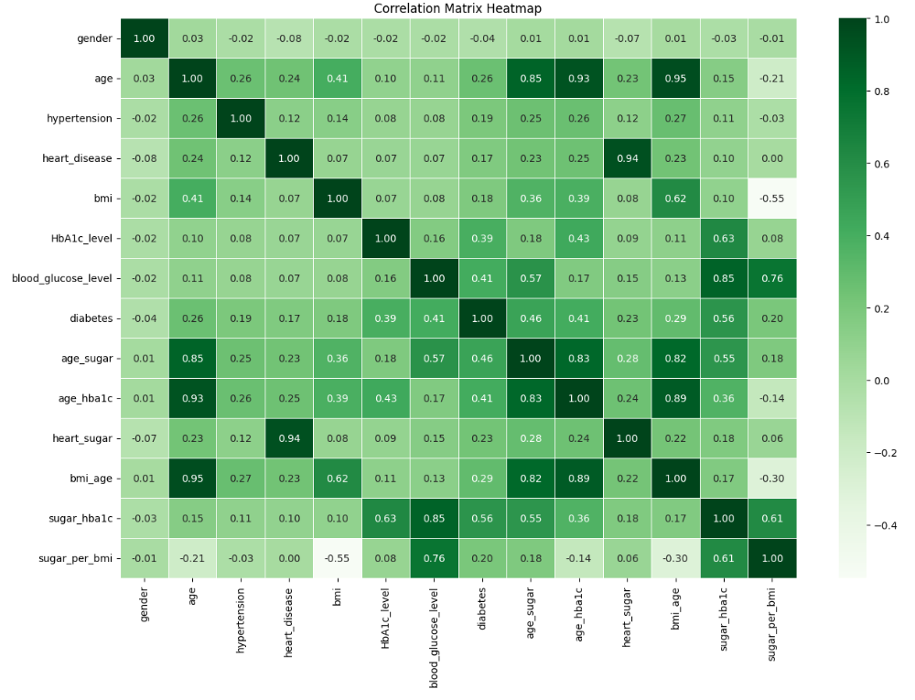
CORRELATION MATRIX

Slide 15
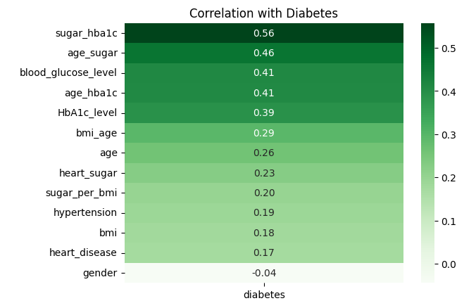
CORRELATION WITH DIABETES

Slide 16
ADDITIONAL MODELS ADDED

Slide 17
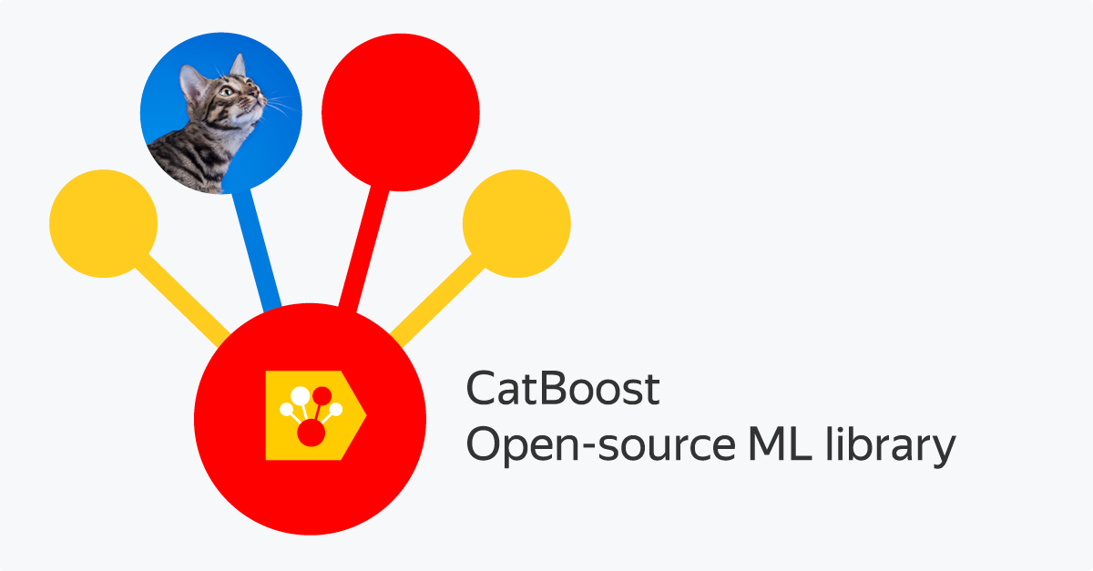
CATBOOST

Slide 18
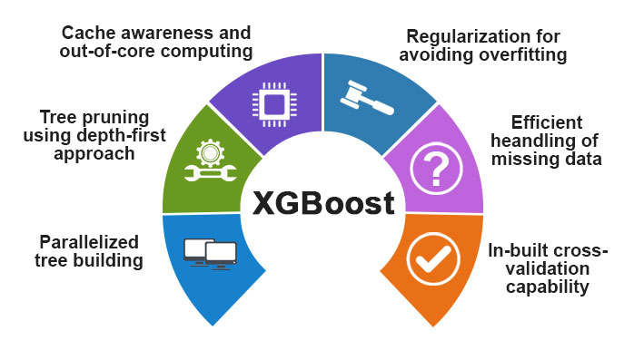
XGBoost

Slide 19
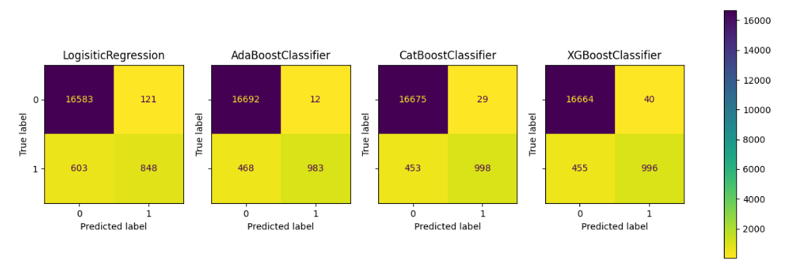
PREDICTIONs As of Now

Slide 20
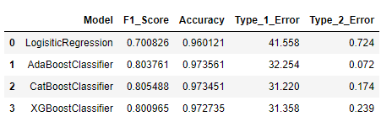
PREDICTIONs As of Now

Slide 21
Sampling techniques

Slide 22
CONTENTS
Undersampling
Oversampling
Combined

Slide 23
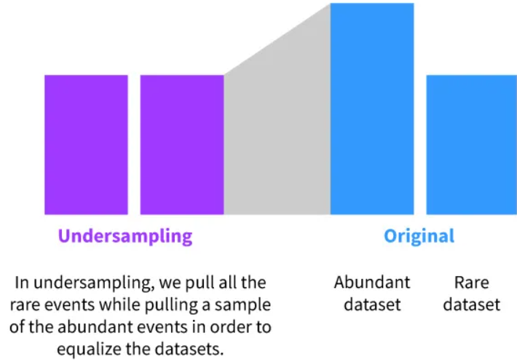
UNDERSAMPLING
RandomUnderSample
Edited Nearest Neighbor
Tomek Links

Slide 24
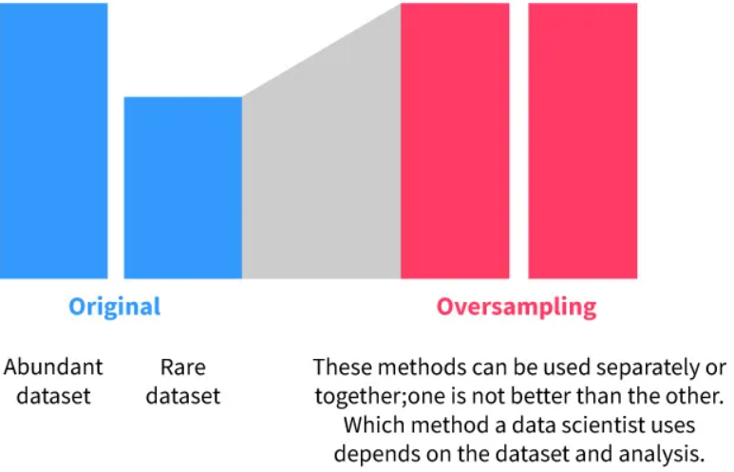
OVERSAMPLING
RandomOverSample
SMOTE

Slide 25
COMBINED
SMOTE-EEN
SMOTE-Tomek

Slide 26
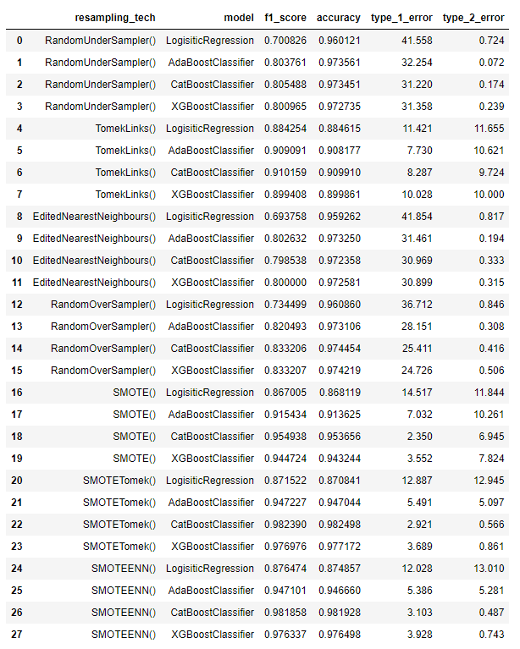
PREDICTIONS AFTER SAMPLING

Slide 27
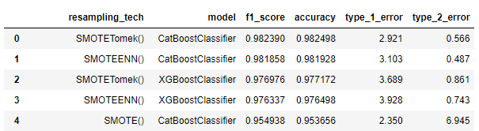
PREDICTIONS AFTER SAMPLING
Top 5

Slide 28
HYPER PARAMETER TUNING

Slide 29
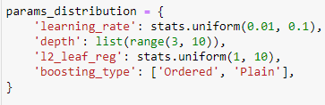

PARAMETERS & GRIDSEARCHCV
CatBoost using SMOTEEN Sampling (#2 in F1, #1 in Type 2 Error)

Slide 30
EVALUATION

Slide 31
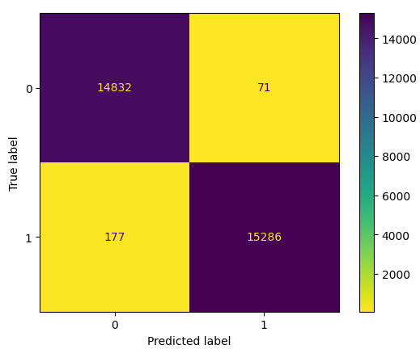
EVALUATION

Slide 32
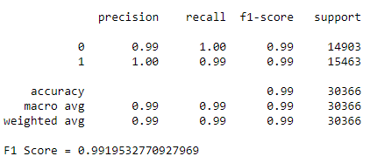
EVALUATION

Slide 33
Thank you :)

